Slide 1
21st CCLC FY27 RFA Technical Assistance Webinar , Part I Grant Purpose, Overview, and Tips
Alaska Department of Education & Early Development
Jessica Paris, 21st CCLC Program Manager
February 25, 2026

Slide 2
Mission, Vision, and Purpose
Mission | Vision | Purpose
An excellent education for every student every day. | All students will succeed in their education and work, shape worthwhile and satisfying lives for themselves, exemplify the best values of society, and be effective in improving the character and quality of the world about them. - Alaska Statute 14.03.015 | DEED exists to provide information, resources, and leadership to support an excellent education for every student every day.

Slide 3

Strategic Priorities: Alaska’s Education Challenge
Five Shared Priorities:
Support all students to read at grade level by the end of third grade.
Increase career, technical, and culturally relevant education to meet student and workforce needs.
Close the achievement gap by ensuring equitable educational rigor and resources.
Prepare, attract, and retain effective education professionals.
Improve the safety and well-being of students through school partnerships with families, communities, and tribes.
education.alaska.gov/akedchallenge

Slide 4
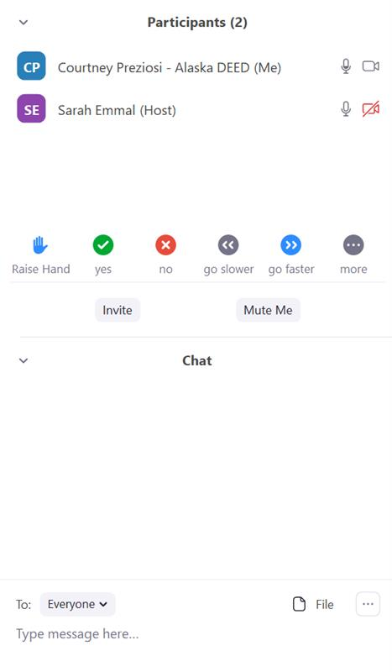

Engage by using the tech:
Transcript: This will display a running transcript. Find by selecting from More button.
Show Captions: This will display live closed captions.
Open your Participant window
Open your Chat window
Locate your Microphone button
Locate your Video button
Locate your Reactions button
Locate Hand-raising button
Audio and Video Settings.
Click icon to turn on or off. Red slash through the icon indicates that it is turned off.
Click arrow (^) to the right of each icon for more settings (e.g., change microphone, virtual backgrounds).
Chat: This will allow you to chat with the Host and other participants.
React: This will allow you to use an emoji to provide a reaction without interrupting the meeting. Reactions will disappear after 5 seconds. Raise Hand might be found here or as its own button
Leave microphone muted until speaking

Slide 5
Before we get started…
This is being recorded
Keep microphone off or telephone muted
Use headphones so your mic does not re-transmit
Use non-verbal tools as appropriate
I will try to pause between major topics for questions
Ask generalized questions relevant to entities other than yourself
If you have a question—
Write in the chat and/or
Raise hand
If only on phone line, wait for pause and then state “I have a question”

Slide 6
Who is here?
In the chat box, type:
Name
Community
Organization
Email address

Slide 7
Agenda
Overview of 21st CCLC
Program logistics
Funding and Eligibility Parameters
Program Quality Considerations
Reporting and other Grantee Requirements
Tips for New Applicants
Applicant Resources
Questions
Next Steps

Slide 8
Overview of 21st CCLC
21st Century
Community Learning Centers Program

Slide 9


21st CCLC funding source
Funded through the U.S. Department of Education
Appropriated by Congress
ESEA - Title IV, part B
Many other federal regulations
Alaska receives about $6 million/year
Distributes through competitive RFA process
DEED plans to run next RFA in 2030

Slide 10

Purpose of 21st CCLC funding
Increase student academic achievement
Provide educational opportunities outside of the school day that align with the regular day
Particularly for students who attend high-poverty, low-performing schools

Slide 11

Academic assistance
English language arts and mathematics instruction
Targeted tutoring, skill building
Homework/classwork help
Credit recovery
Credit accrual
Smaller staff-to-student ratio
Aligns with and supports regular school day

Slide 12

Educational enrichment
Hands-on, project-based, active, experiential, programming that engages students and supports state academic standards:
STEM/STEAM projects, science clubs, coding, robotics, math games
Art, music, cultural activities, theatre, second language, cooking, dance, chess
Structured physical activity—archery, swimming, Native Youth Olympics, Girls on the Run,
Drug and violence prevention, counseling
Career readiness and competency building, employer-recognized credentials, service learning

Slide 13

Social, emotional, non-cognitive, and/or life skills building
Program intentionally designed to support positive youth development
Social/Emotional instructional curriculum
Embedded in project-based learning

Slide 14

Family engagement in student’s education
Family Nights
Literacy training
Training in school online support resources
Educational resources and activities
Facebook and newsletter stories
Parent surveys
Parents as volunteers, instructors, advisors
(One event required per term)

Slide 15

Free snack or meal without using 21st CCLC $
USDA National School Lunch Program--Afterschool Snack
USDA Child and Adult Care Food Program At-Risk--Meal or Snack
USDA Summer Food Service Program--Meals or Meal and Snack
For schools/centers with Economically Disadvantaged rate of 50% or more, USDA provides reimbursement for 100% of students
DEED oversees these federal programs in Alaska
If don’t run USDA program, must find other funding source
If fully operate a USDA program, may be able to use 21st CCLC funds for any “gap” between running program and reimbursement rate

Slide 16

Safe transportation to and from program
Contract for bus
Wages for driver of school vehicle
Everyone safely walks

Slide 17
Program Logistics
21st Century
Community Learning Centers Program

Slide 18

When is programming?
Required: Consistent programming during school year
Typically 2 or 2.5 hours, 4 or 5 days per week
Right after school day
Before school (typically only 30 - 60 minutes)
Evenings (for HS Students)
Must offer at least 220 hours per center during school year
Optional: Summer
Typically half or full day, 4 or 5 days per week
Must offer at least 90 hours per center if do summer
Additionally:
Saturdays (particularly for parent involvement)
Winter or spring break (typically full day, 5 days)

Slide 19

Where are the “centers”?
Safe
Current safety inspections
Accessible
ADA compliant
Site not a barrier to transportation
Convenient
Students
Staff
Families
Economical
= School Buildings

Slide 20

Who are the staff?
Administrative:
Program Director (.25 to 1.0 FTE)
Site Coordinator (.5 to 1.0 FTE)
Teacher in Charge/ Lead Staff (15 hours per week)
Instructional:
Teachers on extra duty stipend
Paraprofessionals on hourly wage
In-kind staff from school or community partners
Contracted from local non-profits and for-profits
High school students earning wage or HS Credit
Volunteers, including AmeriCorps
See pages 11-12 in the RFA

Slide 21
Effective management structures
1.0 Director, 5 X .75 Site Coordinators, 5 large sites
0.5 Director, 4 x 1.0 Site Coordinators, 4 large sites
1.0 Director, 4 X 0.5 Site Coordinators, 4 medium sites
.25 Director, 1 x 1.0 Program Coordinator, 4 Teachers in Charge, 4 small sites
1.0 Director/Site Coordinator, 1 medium site

Slide 22
What are effective program schedules?
Variety of classes and choice that attract voluntary participation and meet student needs and match staff skills
Sustained units (not one-offs) that allow students to progress
Participation in different types of programming (e.g. academic and enrichment and SEL) is allowed/encouraged/required
“Veggies” shouldn’t have to compete with “dessert”
Small class sizes that allow for more 1 on 1, student leadership, relationship building, staff who can’t manage 30 students
One- or two-day commitment per week from instructional staff allowable
One “super” or “club” day different from other days
Ability to earn high school credit or employer- or industry-recognized credential
Coordinated with other popular programming instead of competing

Slide 23

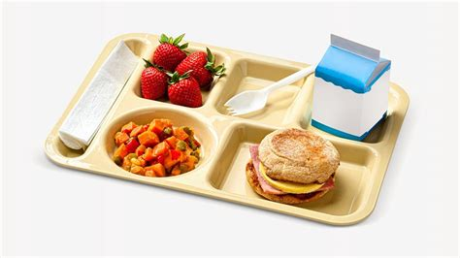
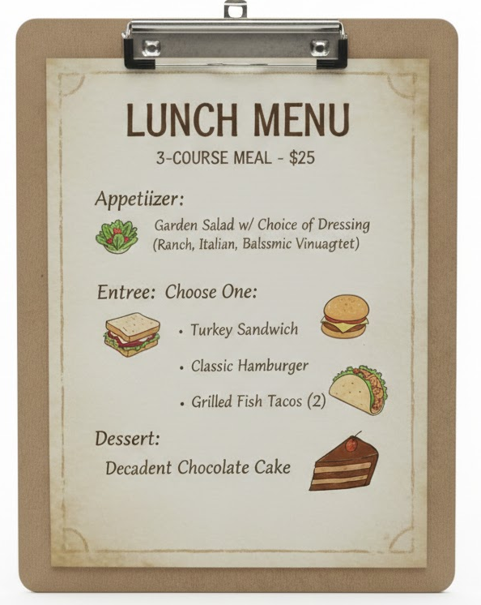

What are effective program analogies?
Less Effective
More Effective

Slide 24
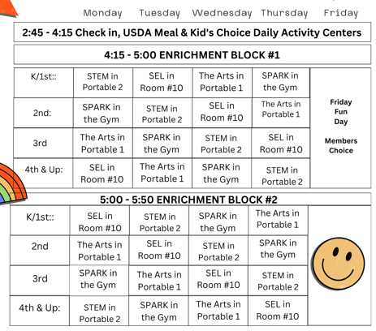
Example elementary schedule

Slide 25
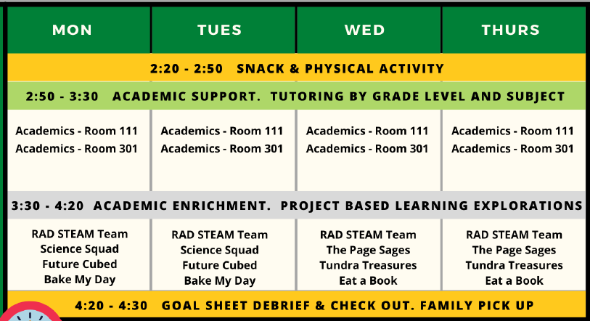
Example middle school schedule

Slide 26
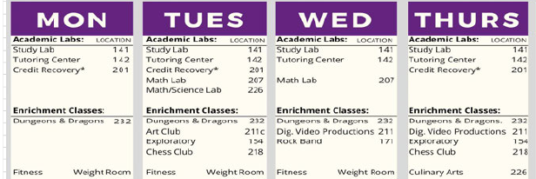
Example high school schedule

Slide 27
Additional features of 21st CCLC programs
Regular attendees
All program participants must be enrolled in program
Must attend at least 75 hours to be counted as regular attendee
Target Cost and reasonable funding based on regular attendees
See page 22-23 in RFA
Coordination
With pre-existing and concurrent programs
With other federal, state, and local funds
With regular school day
Evaluation process
Data
External observation
Performance Indicators
Ongoing Continuous Quality Improvement

Slide 28
What 21st CCLC is NOT
Study hall—No: Planned lessons, small student-teacher ratio
Random disconnected clubs/activities —No: Center with overarching elements
Mandatory intervention—No: Voluntary
A way to buy expensive equipment—No: Unless supported by quality staffing
A way to fund school’s favorite clubs—No: Supplanting
A way to build/fund a rec center—No: Construction not allowed
A way to fund out-of-town student trips—No: Educational field trips that are aligned with programming and within community only
Tuition/scholarships to send students to other camps, schools, or programs—No: This is the learning center
Safe space to have fun—No: Much higher expectations

Slide 29

Purpose of 21st CCLC funding repeated
Increase student academic achievement

Slide 30
Funding and Eligibility Parameters

Slide 31

Who can apply?
Any public/private organization can apply
School districts
Faith-based organizations
Community-based organizations
Tribal organizations
Combination
Essential to collaborate with students’ school
Ten Priority Points
External Organization Pool

Slide 32
Who should apply?
School District
as lead applicant in coordination with school and in partnership with local organizations
Ensure it’s actually desired by school and community
Doesn’t harm community non-profits
Variety of programming
Priority points
Local Non-profit
as lead applicant in partnership with school district and other organizations
Ensure it’s actually desired by school and community
Need data sharing agreements, academic support, facility from school
Priority points

Slide 33
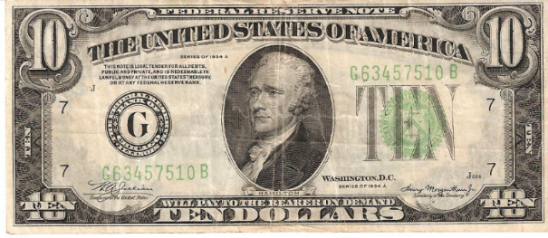
Funding parameters
Between $50,000-$900,000 per year
Awarded annually for 5-years, contingent on federal funding
This competition will likely fund 7 - 9 new grants
Program is free of charge for participants
Option to charge nominal fee but subtracted from award
Funds must “supplement not supplant” existing federal, state, local, and non-federal/private funds
Begins July 1, 2026

Slide 34
Supplement not supplant
Supplement = Allowed
Create brand new program
Supplant = Not Allowed
Offer the same programming you offered in the prior year but swap how it is paid for
Add/replicate successful program at a new additional site
Double the number of students previously served; double the number of days of operation. 21st CCLC pays only for the new students/services.
Use 21st CCLC funds to operate a program previously funded by COVID money that died September 2024.
Significantly add on to a current program and fund pre-existing part with non-21st CCLC funds
Incorporate traditionally offered activities into a 21st CCLC program and pay for the activities using 21st CCLC funds
Use 21st CCLC funds to operate a program previously funded by the district’s BSA, Title I-A, Title IV-A, CTE, etc.
Use 21st CCLC funds to operate a program previously funded by fundraising activities.
Use 21st CCLC funds to pay for an activity required by federal, state or local law
Use 21st CCLC funds to operate a program previously funded by a 21st CCLC grant that ends June 30, 2025.

Slide 35
Supplement not supplant continued
Congress intends 21st CCLC funds to provide programming and activities that would not occur if this funding didn’t exist.
One ways to understand “supplement not supplant” is to acknowledge that it is somewhat unfair.
21st CCLC isn’t a funding source to help pay for what you are already doing; it’s a comprehensive program in its own right.
More guidance on Supplement not Supplant

Slide 36
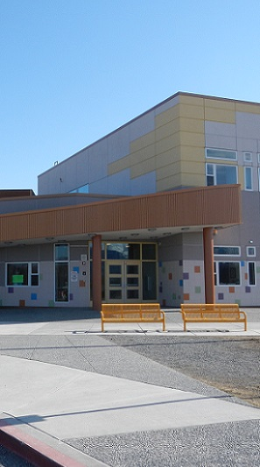
Who is eligible for services?
Schools
Students in K-12
At least 60% of the students served must attend schools with poverty rates of 40% or greater or Title I schoolwide sites
See 21st CCLC DEED School Data Sheet for FY27 RFA

Slide 37
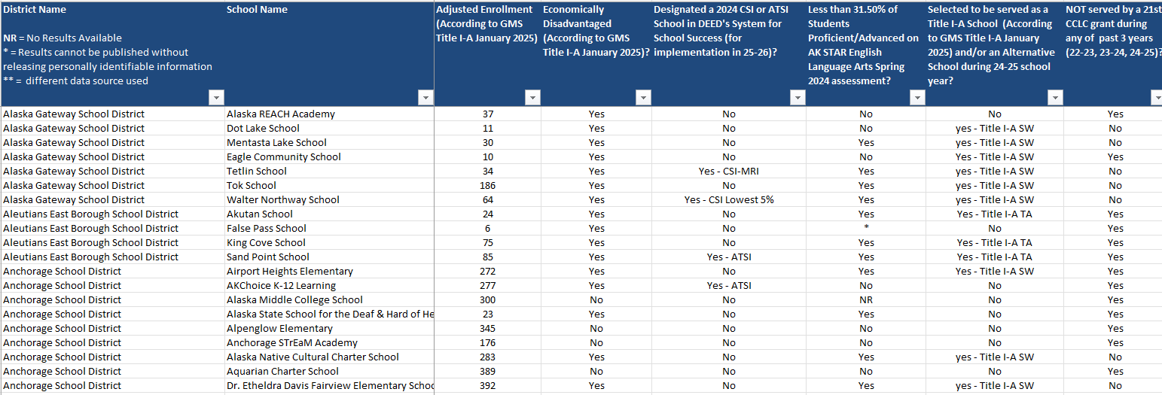
Who is the priority population?
Priority population is students who attend schools that are--
2027 Comprehensive Support & Improvement, Targeted Support & Improvement, or Additional Targeted Support & Improvement (CSI, TSI, or ATSI) for 26 – 27 Implementation
Fewer than 32.69% were proficient/advanced on Spring 2025 AK STAR ELA
Title I-A site (SW or TA) or Alternative School
Not served by 21st CCLC during past 3 years
See the 21st CCLC DEED School Data Sheet for FY27 RFA

Slide 38
Program Quality Considerations

Slide 39

Why will students want to attend?
Positive atmosphere
Relationships with peers and adults
Community and belonging
Leadership and responsibility
Voice and choice
Food (not with 21st CCLC funds)
Variety of engaging programming
New ideas, activities, opportunities
Support to succeed in school
Regular attendance encouraged

Slide 40

How is staff quality ensured?
Organizational support for program
Appropriate hiring practices, including background screening
Provide training and PD
Provide time to plan
Staffing appropriate for the program and realistic for community
Clear contracts and job descriptions
Support from the fiscal staff

Slide 41

Why are partnerships important?
Staffing
Programming variety and expertise
Staff that know/reflect the local culture
Programmatic funding and/or in-kind support
Sustainability

Slide 42
How do we ensure program quality?
Measures of Effectiveness embedded in RFA
Must set and track goals and performance indicators
Must contract and work with external evaluator
Must attend meetings, trainings, and conferences
Review PQA or other youth program quality tools and frameworks
Many, many online resources for afterschool or out-of-school-time programming, such as
The Alaska Afterschool Network

Slide 43
Reporting and other Requirements

Slide 44
Reporting and requirements
Data Collection:
Must collect a variety of program and individual participant data throughout the year in order to report on federal and state performance indicators, as well as local performance indicators the grantee will set.
Individual student data include items such as demographic information, program attendance, grade point average, and teacher surveys on student progress.
Such data is submitted via Excel workbooks and using online tools.
Federal and State Reporting:
Center Data Workbooks for every center school year and summer (attendance, teacher survey, operations data, partners)
Annual Narrative Reflection, Sustainability Plan, Evidence of Consultation with private schools
Federal Profile and Performance data entered online in 21apr (due 2 times per year)
Grantees determined to be “at-risk” may be required to submit additional or more frequent data or reports
Local Evaluation:
In first year, select performance measures/indicators that align with the objectives of local program. Data to measure performance will be submitted to DEED’s external evaluator to create an annual Local Evaluation Report
Contract a trained external evaluator to observe program at least once per year and write up the assessment and recommendations
Use all this evaluation data to self-assess progress and set goals for program improvement annually

Slide 45
Reporting and requirements continued
Participation in Training, Technical Assistance, and PD:
Directors in-person meeting(s), online meetings, state conference, national conference
Budget:
Budget and budget narrative (submitted annually in spring via online Grant Management System)
Budget reimbursement requests (submitted quarterly via online Grant Management System)
Compliance Monitoring:
Conducted by DEED Program Manager; once in five years or more if needed; typically in 2nd year
Grantee submits documents to demonstrate compliance
Involves site observations

Slide 46
Tips for New Applicants

Slide 47
Tips for implementation and application
Don’t understaff the key management positions: Site Coordinator and Director.
Don’t try to serve too many centers; consider starting with one.
Consider focusing on a specific grade level: Instead of serving four schools grades K-12, try serving just K-5 at the four schools.
Don’t design programming that is overly narrow; it reduces adaptability. Maybe it is most appropriate for your organization to be a specialized partner who provides quality programming as just one part of a 21st CCLC program.
Take the needs assessment section seriously. Don’t write a grant that will compete instead of cooperating with the community’s current resources. Don’t submit application if school or community does not support the program.
Don’t overestimate the number of “21st CCLC regular attendees” who will voluntarily attend 75 hours or more; funding will be reduced; for typical K-12 school the average attendance is 35% of elementary students and 10% or less of secondary (could consider not serving).

Slide 48
Tips for implementation and application continued
Consider contracting a grant writer; your organization will still have much work to do to submit a grant application that is compelling and able to be implemented; can’t pay with grant funds.
Don’t reduce existing programming and don’t try to supplant how the existing programming is funded; your community will tattle on you.
Keep track of how much it will cost per “regular attendee” and per “student hour” (hours of programming x regular attendee); too high a cost per student or student hour won’t be competitive; don’t “pad;” don’t make it too expensive for the probable gain (form on page 42).
Remember that federal funds have many restrictions (incentives, snacks, celebratory food, entertainment are unallowable costs); additionally, costs must be “reasonable and necessary;” instead, can organization provide and list as in-kind support?
Don’t focus on reviving a derelict building; must meet ADA compliance and safety regulations; try to use school.

Slide 49
Applicant Resources

Slide 50
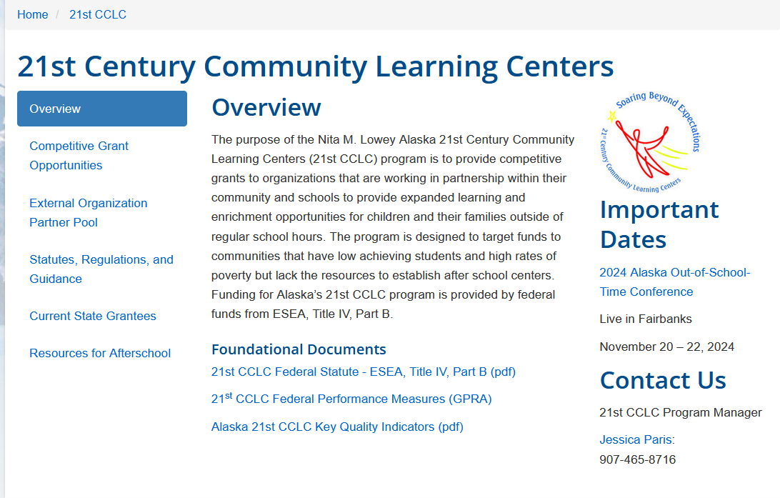
DEED 21st CCLC website
DEED 21st CCLC Website

Slide 51
Online and print resources
21st CCLC NTAC
Alaska Afterschool Network
Afterschool Alliance
Foundations, Inc
What Works Clearinghouse
Weikart Center for Youth Program Quality

Slide 52
Questions?

Slide 53
Questions
Can we apply only to do summer programming?
Must we include summer programming?
Do we have to supply an afterschool snack or a meal?
Can we use grant funds for the snack or meal?
Can we use funds for bus routes home?
Instead of a “center,” can we simply meet in a school?
Can a non-profit apply solo without partnering with a school district?
Can we charge participants a fee to attend?
If this isn’t the right funding source for what we want to do, what is?

Slide 54
Answers
Can we apply only to do summer programming? No
Must we include summer programming? No
Do we have to supply an afterschool snack or a meal? Yes
Can we use grant funds for the snack or meal? No
Can we use funds for bus routes home? Yes
Instead of a “center,” can we simply meet in a school? Yes
Can a non-profit apply solo without partnering with a school district? Yes, but harder for application to be competitive and harder to implement
Can we charge participants a fee to attend? Yes, but strongly discouraged, must be nominal/sliding scale, can’t make a profit, subtracted from award
If this isn’t the right funding source for what we want to do, what is? Try I-A, IV-A, REAP RLIS or SRSA, CTE, SIF, ANE, AAN mini grants, DOH PYDAP

Slide 55
Next Steps and Contact Information

Slide 56
Next steps
Participation in technical assistance opportunities – next one Friday!
Research
Community meetings
Schools,
Private Schools,
Tribes,
Partners
Local grant preparation and planning
Intent to Apply is due March 5, 2026
Application is due April 1, 2026

Slide 57
Contact information
Jessica Paris, 21st CCLC Program Manager
jessica.paris@alaska.gov
(907) 465-8716
Website: www.education.alaska.gov/21cclc/

Slide 58
Stay connected
Website
education.alaska.gov
Social Media
@AlaskaDEED
Phone
Main Line: (907) 465-2800
Teacher Certification: (907) 465-2831

